Slide 1
Algoritma & Pemrograman
Arrays
Prepared by
Frans Panduwinata, S.Kom, M.T

Slide 2
Defining Arrays
An array contains multiple objects of identical types stored sequentially in memory.
The individual objects in an array, referred to as array elements, can be addressed using a number, the so-called index or subscript.

Slide 3
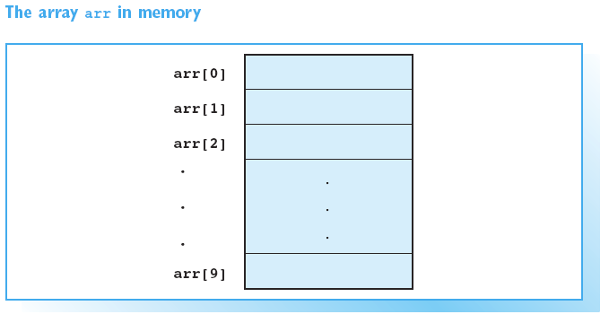
Defining Arrays (cont)

Slide 4
Defining Arrays (cont)
An array must be defined just like any other object. The definition includes
  The array name and
  The type and number of array elements.
SYNTAX:
type name[count]; // Array name
count is an integral constant or integral expression containing only constants.

Slide 5
Defining Arrays (cont)
EXAMPLE:
float arr[10]; // Array arr
This statement defines the array arr with 10 elements of float type.
An array always occupies a contiguous memory space.
In the case of the array arr, this space is 10*sizeof(float) = 40 bytes.

Slide 6
Index for Array Elements
The subscript operator [ ] is used to access individual array elements.
An index always begins at zero. The elements belonging to the array arr are thus
arr[0], arr[1] , arr[2], ... , arr[9]
No error message is issued if the index exceeds the valid index range.

Slide 7
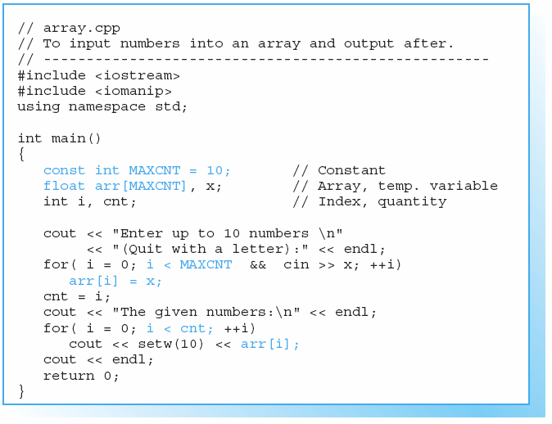
Sample Program

Slide 8
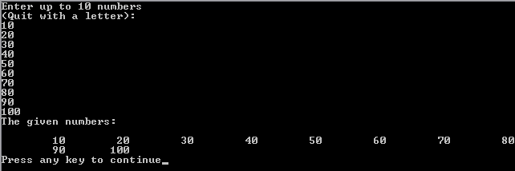
Sample Program (cont)
Screen Output:

Slide 9
Initialization List
A list containing the values for the individual array elements is used to initialize the array.
EXAMPLE:
int num[3] = { 30, 50, 80 };
A value of 30 is assigned to num[0], 50 to num[1], and 80 to num[2].

Slide 10
Initialization List (cont)
If you initialize an array when you define it, you do not need to state its length.
EXAMPLE:
int num[] = { 30, 50, 80 };
In this case, the length of the array is equal to the number of initial values.

Slide 11
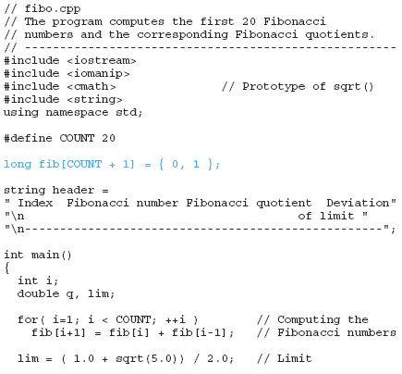
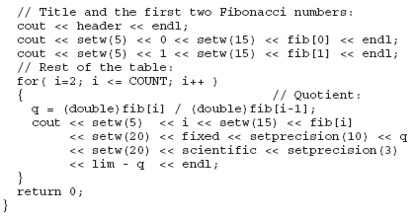
Sample Program

Slide 12
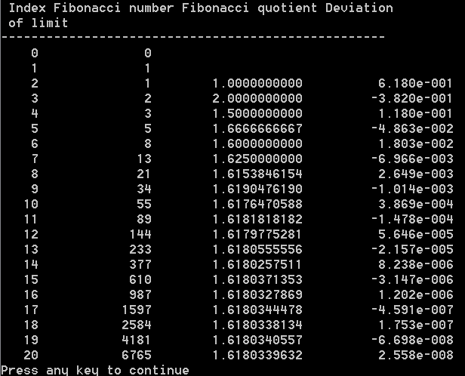
Sample Program (cont)
Screen Output:

Slide 13
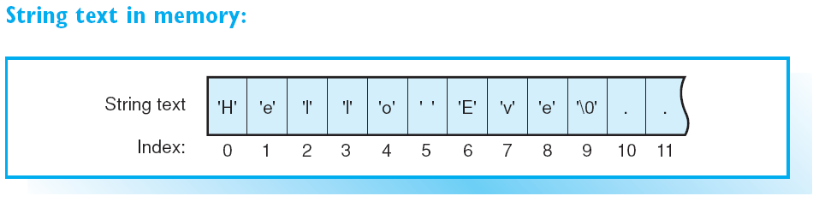
Initializing
char text[40] = "Hello Eve";
The array text has length of 40, whereas the string “Hello Eve" only occupies the first 9 bytes.

Slide 14
char Arrays
EXAMPLE:
char name[] = "Hugo";
This definition is equivalent to char name[] = { 'H','u','g','o','\0' };
The string name occupies five bytes, including an additional byte for the null character.

Slide 15
C Strings and the string Class
C strings are simple char arrays.
EXAMPLE:
char str1[20], str2[20] = "A string";
str1 = str2; // Error!
strcpy( str1, str2); // ok!
The standard functions of the C language, such as strlen(), strcpy(), strcmp(), and others, are available for C strings.

Slide 16
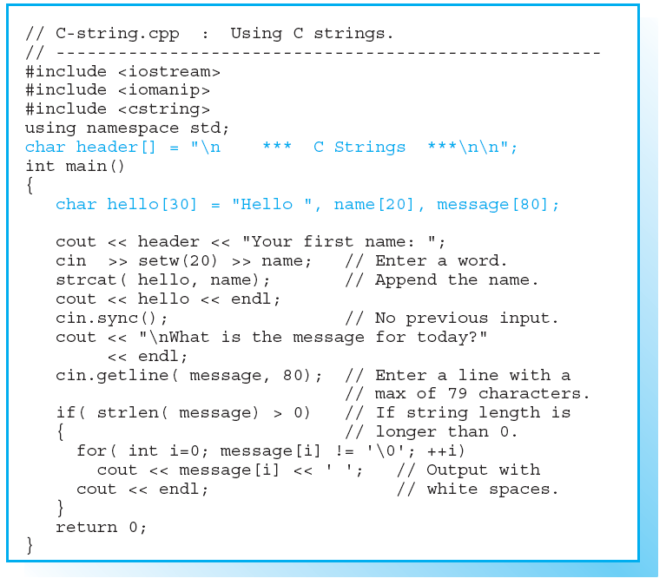
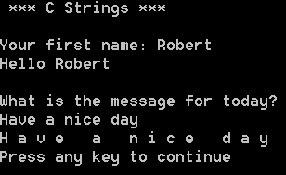
Sample Program
Screen Output:

Slide 17
Defining Multidimensional Arrays
The most common multidimensional array type is the two-dimensional array, the so called matrix.
EXAMPLE:
float number[3][10]; // 3 x 10 matrix
This defines a matrix called number that contains 3 rows and 10 columns. Each of the 30 (3 x 10) elements is a float type.
EXAMPLE:
number[0][9] = 7.2; // Row 0, column 9
stores the value 7.2 in the last element of the first row.

Slide 18
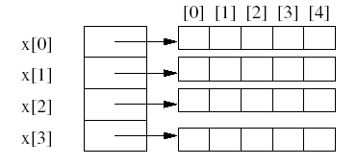
Two-Dimensional Array
Two-dimensional array is represented as a one-dimensional array in which each element is, itself, a one-dimensional array.
EXAMPLE:
The array int x[4][5];

Slide 19
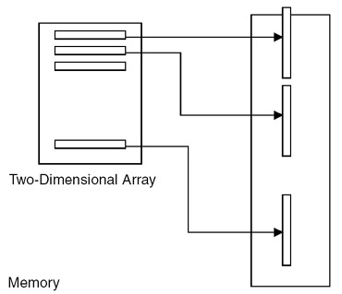
Two-Dimensional Array (cont)
Representation of two-dimensional arrays

Slide 20
Arrays as Array Elements
The initialization list of a two-dimensional array thus contains the values of the array elements, that is, the one-dimensional rows.
EXAMPLES:
int arr[2][3] = { {5, 0, 0}, {7, 0, 0} };
int arr[][3] = { {5}, {7} };
You can only omit the size of the first dimension.
It is necessary to define any other dimensions since they define the size of array elements.

Slide 21
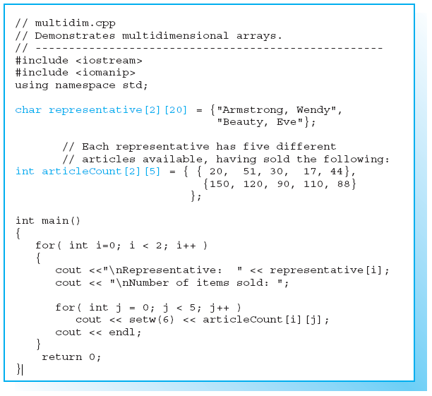
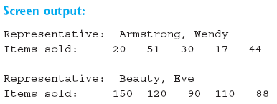
Sample Program

Slide 22
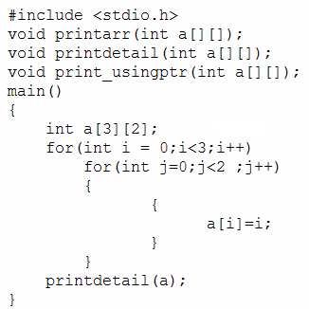
Sample Program (cont)
EXAMPLE:

Slide 23
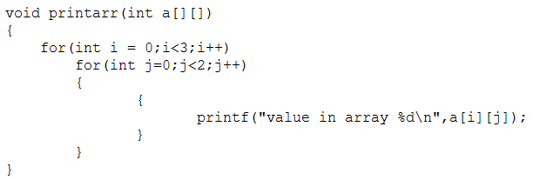
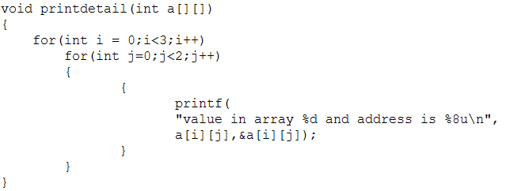
Sample Program (cont)
EXAMPLE:
(cont)

Slide 24


Sample Program (cont)
EXAMPLE of two-dimensional array implementation:
Transpose of a matrix.
The transpose of a matrix is obtained by interchanging the rows with the corresponding columns
void trans(int mat[][3],int tr_mat[][3], int k ,int l)
{
  int i,j;
  for(i=0;i<k;i++)
  for(j=0;j<l;j++)
  {
  tr_mat[i][j]=mat[j][i];
  }
  }
transpose

Slide 25
Three-Dimensional Array
Just as with a two-dimensional array, you can define three-dimensional arrays and processing in a similar way.
Each three-dimensional array is taken as an array of two-dimensional arrays.

Slide 26
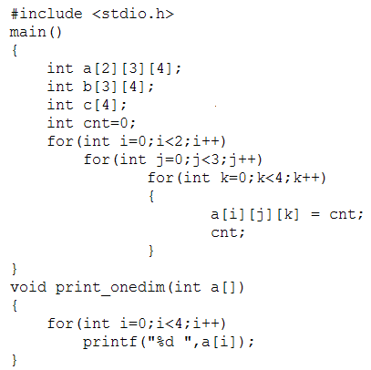
Three-Dimensional Array (cont)
EXAMPLE:

Slide 27
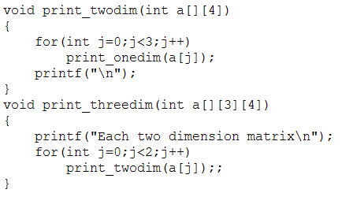
Three-Dimensional Array (cont)

Slide 28
Exercises
EXERCISE 1
Sample output:
Number of input (max. 20): 3
Enter numbers:
Input 1: 35
Input 2: 11
Input 3: 7
Even number : none
Odd number : 35, 11 and 7
Use array and design your own functions!

Slide 29
Exercises (cont)
EXERCISE 2
Sample output:
Number of input (max. 20): 5
Enter numbers:
Input 1: 35
Input 2: 11
Input 3: 7
Input 4: 4
Input 5: 2
Max. number is 35 and min. number is 2
Use array and design your own functions!

Slide 30
Exercises (cont)
EXERCISE 3
Sample output:
Number of input (max. 20): 5
Enter numbers:
Input 1: 35
Input 2: 11
Input 3: 7
Input 4: 4
Input 5: 2
Calculation: 35 – 11 – 7 + 4 + 2 = 23
Use array and design your own functions!

Slide 31
Exercises (cont)
EXERCISE 4
Write a program using 2-D Array and Functions to calculate
the sum of two matrix.
Matrix 1:
11 42 39
44 5 86
Matrix 2:
12 36 9
1 8 9
The Sum of Matrix 1 & Matrix 2:
23 78 48
45 13 95

Slide 32
Exercises (cont)
EXERCISE 5
Write a program using 2-D Array and Functions.
Number of Row(s) : 2
Number of Column(s): 3
Row 1 Column 1: 1
Row 1 Column 2: 2
Row 1 Column 3: 3
Row 2 Column 1: 4
Row 2 Column 2: 5
Row 2 Column 3: 6
Your Data:
1 2 3
4 5 6
Sum Row(s) and Column(s):
1 2 3 6
4 5 6 15
5 7 9 21

Slide 33
Exercises (cont)
EXERCISE 6
Write a program using 2-D Array and Functions.
Number of Row(s) : 5
Number of Column(s): 3
| 1 2 3
----------------
1 | 1 1 1
2 | 2 4 8
3 | 3 9 27
4 | 4 16 64
5 | 5 25 125

